Slide 1
Capstone Project-The Battle of Neighborhoods
Chicago Illinois

Slide 2
Introduction
Background
decision on store-locations is one of the most important strategic decisions the retailer has to make for its long term success. Finding the right location for a new store is a process that takes careful consideration. Population, neighborhood demographics, income distribution, crime rate, local competition are all factors taken into consideration when grocery chains look for a new store location.
Problem
The aim of this project is to find location for opening of retail store, specifically grocery stores location across Chicago. This report will be targeted to stakeholder’s interest in opening grocery store in community area with low crime rate and higher per capita income.

Slide 3
Methodology
Data Acquisition
The data acquired for this project is a combination of data from three sources.
The first source of data is scraped from a Wikipedia page that contains the list of Chicago community area.
The second data source of the project uses a Chicago crime data that shows the crime per community area in Chicago.
Third data source is Chicago Census Data - Selected socioeconomic indicators in Chicago, 2008 – 2012. This dataset contains a selection of six socioeconomic indicators of public health significance and a “hardship index,” for each Chicago community area, for the years 2008 – 2012

Slide 4
Methodology
Data cleaning and processing
The data cleaning for each of the three sources of data is done separately.
The First data is scraped from a Wikipedia page using the Beautiful Soup library in python. Using this library we can extract the data in the tabular format as shown in the website
The second data from the Chicago crime data, the crimes during the most recent year (2020) are only selected. The major categories of crime are segregated group by community area code to get the total crimes per the community area
The third dataset Chicago Census Data - Selected socioeconomic indicators in Chicago, 2008 – 2012

Slide 5
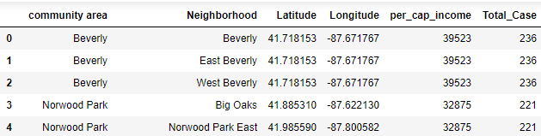
Data cleaning and processing(Cont.)
The two datasets are merged on the Community area names to form a new dataset that combines the necessary information in one dataset
The coordinates of the neighborhoods is be fetched using Open Cage Geocoder to create a final consolidated dataset of the Neighborhoods, along with their boroughs, crime data and the respective Neighborhood’s co-ordinates

Slide 6
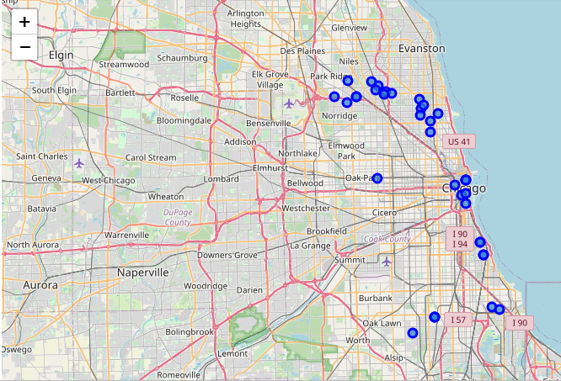
Neighborhood in Chicago
Neighborhoods with high per capita income and lowest crime rate were selected. There are 35 neighborhoods which has been selected with above criteria, they are visualized on a map using folium on python

Slide 7
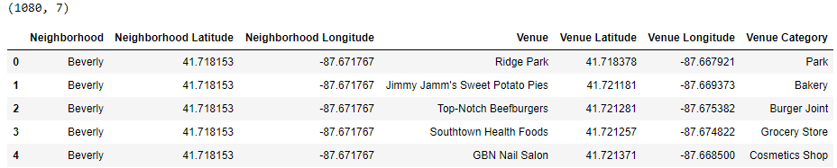
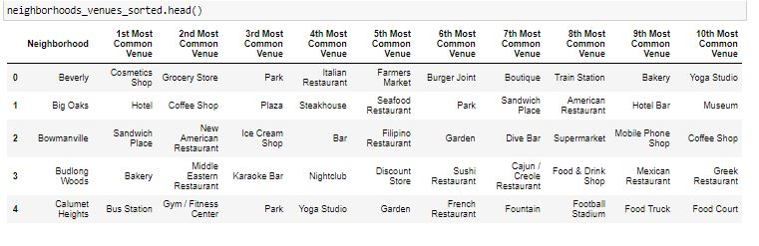
Modeling
Using the final dataset containing the selected neighborhoods along with the latitude and longitude, we can find all the venues within a 500 meter radius of each neighborhood by connecting to the Foursquare API
One hot encoding is done on the venues data. The Venues data is then grouped by the Neighborhood and the mean of the venues are calculated, finally the 10 common venues are calculated for each of the neighborhoods

Slide 8
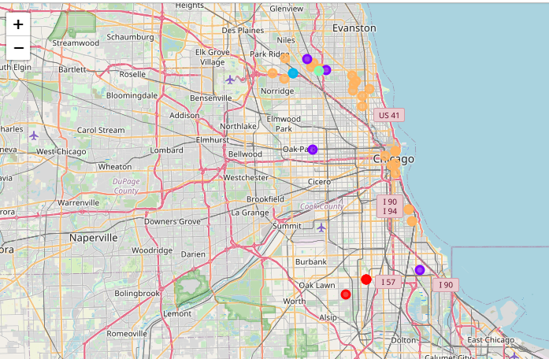
Results
After running the K-means clustering we can access each cluster created to see which neighborhoods were assigned to each of the five clusters. Visualizing the clustered neighborhoods on a map using the folium library
Each cluster is color coded for the ease of presentation

Slide 9
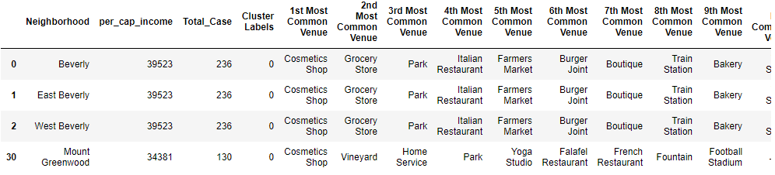
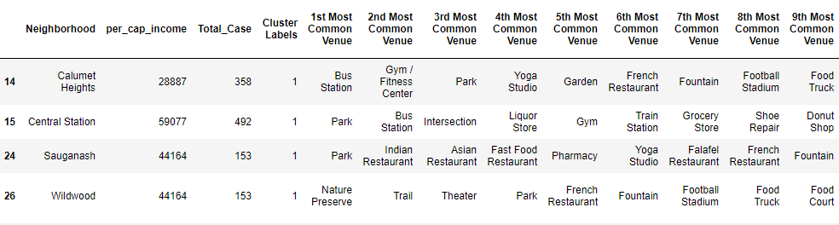
Cluster 1: Looking into the neighborhoods in the first cluster. Upon closely examining these neighborhoods we can see that the most common venues in these neighborhoods are Cosmetic Shop, Grocery Store, Parks, Bakery, Restaurant and stadium
Cluster 2 Looking into the neighborhoods in the second cluster clustered from, Forest glen, Calumet Heights, Near South Side which consist of venue such as Bus Station, Park, Nature Preserve

Slide 10
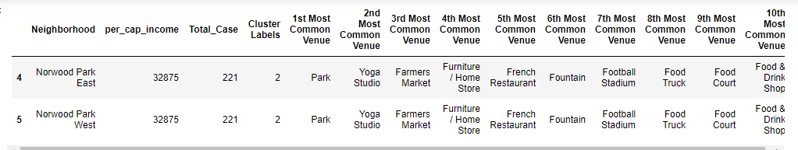
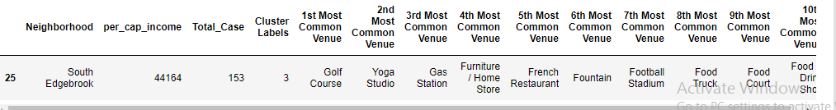
Cluster 3: Neighborhood in third cluster ,clustered from, Norwood Park having similar common venues, the most common venues in these neighborhoods are Park, Yoga studio, Farmers market
Cluster 4: Looking into the neighborhood in fourth cluster, the most common venues in these neighborhoods are Golf Course, Yoga studio, Gas Station, Furniture Store , French Restaurant

Slide 11
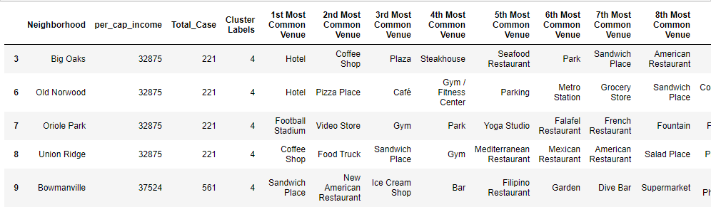
Cluster 5: Looking into the neighborhood in fifth cluster. The cluster five is the biggest cluster with 24 of the 35 neighborhoods. Upon closely examining these neighborhoods we can see that the most common venues in these neighborhoods are Hotel Cafe, Restaurants, Football Stadium, Coffee Shop, and Yoga Studio

Slide 12
Results and Discussion
The objective of the business problem was to help stakeholders identify one of the safest Neighborhood with higher per capita income in Chicago Illinois, and an appropriate neighborhood within the community area to set up a commercial establishment especially a Grocery store. This has been achieved by first making use of Chicago crime data to identify a safe community area with considerably higher per capita income for any business to be viable. After selecting the community area it was imperative to choose the right neighborhood where grocery shops were not among top 10 most common venues in a close proximity to each other. We achieved this by grouping the neighborhoods into clusters to assist the stakeholders by providing them with relevant data about venues and safety and population with higher individual income of a given neighborhood.

Slide 13
Conclusion
We have explored the crime data to understand different types of crimes in all Community area of Chicago and later segregate them based on per capita income, this helped us for selecting area with high per capita income and lowest crime rate. Once we confirmed the community area the number of neighborhoods for consideration also comes down, we further shortlist the neighborhoods based on the common venues, to choose a neighborhood which best suits the business problem.

